Slide 1
ICS4ICS and INL: Work For Development (WFD)
<event title>
<name>
<title>
<date>

Slide 2
WFD Overview
Notes:
We will now provide a brief overview of the ICS4ICS program.

Slide 3
WFD Project: Explanation and General Approach Purpose for creating WFD data to support ICS4ICS
Work Force Development (WFD) Skills Assessments are needed to define the skills for Operational Technology/Industrial Control System (OT/ICS) and other roles that support Incident Command System for Industrial Control Systems (ICS4ICS). This assessment data can be used by asset owners to create staff training and development plans. There are numerous valuable uses for this data. This data can also be used by asset owners to determine the skills they need to staff their ICS4ICS Team by identifying roles that need to be staffed through Staffing Alternatives including Mutual Aid agreements.
Project Approach
Identify a single role for an Assessment sample.
Complete the task assessment of the first role.
Document skills needed to perform ICS4ICS tasks unique to organizational needs.
Document the gaps in current tasking and skills for Cyber Response/ICS4ICS.

Slide 4
WFD Project: Detailed approach Steps used in the WFD project
Work Force Development (WFD) steps performed with ICS4ICS volunteers:
Identify common OT/ICS and ICS4ICS roles needed to create a skills inventory.
Review list of roles with a group of experts to obtain input.
Create a task inventory for each of the roles (Project Phase I).
Utilize a group of experts to create a list of tasks for each role.
Create a set of skills to be competent to perform the tasks (Project Phase II).
Utilize a group of experts to build out skills for each task.
Define a process to use skills assessment data to help asset owners perform a skills gap analysis to determine staffing needs. Questions for the team:
Does the organization have a list of the needed ICS4ICS roles?
Does the organization have the roles to perform ICS4ICS tasking?
Does the organization have access to staff with skills needed for incident response?

Slide 5
Common Roles for OT, IT, Cybersecurity, and NIMS/ICS Each role has some Cyber Incident Response and ICS4ICS tasks
OT/Industrial Control System (OT/ICS)
OT/ICS Analyst
OT/ICS Engineer
OT/ICS Technician
OT/ICS Cybersecurity Analyst
OT/ICS Network Administrator (align with IT Network Analyst)
IT (IT, OT/ICS, and/or Cyber focused)
Network Analyst
Server/Host Analyst
Desktop Analyst
Cloud Analyst
System Administrator
ICS4ICS Cybersecurity
ICS4ICS Intelligence Officer
Computer Incident Response (SOC)
Forensics
With Malware Reverse Engineering
Cybersecurity Engineer
Threat Intelligence/Vulnerability Analyst
Incident Command System (NIMS/ICS)
Incident Commander
Operations, Planning, Logistics, and Admin/Finance Section Chiefs
Safety Officer
Public Information Officer
Notes:
We will add: BCP and DR Coordinator / Analyst
We will expand these sub-roles: Forensics (Network, Server/Host Forensics, Cloud)

Slide 6
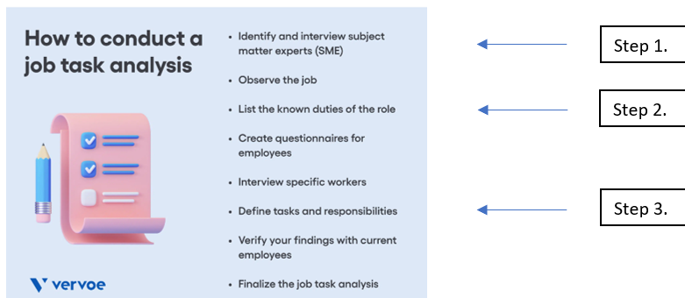
Project Phase I Identifying the tasks performed by each role
For volunteers to build a task list it was important to understand the concept of a job task analysis. As such a job task analysis evaluates a job, rather than the person doing the job, to understand the larger work responsibilities associated with each position. This data-driven process seeks to develop an overview of the knowledge, job tasks, and responsibilities that an employee must master to be successful in a specific role.
We performed the following steps to build a task list:
By performing job task analyses, companies can begin to understand skill gaps, identify training needs, write a job description that entices more candidates to apply, and develop fair hiring practices. Notably, this process does not seek to identify the “ideal candidate” — rather, job task analyses help the company document each part of the job

Slide 7
Project Phase II Identifying the job skills required by each role
After creating the job roles and building a list of tasks for each, the next step is to make a list of specific skills that are required to be effective in the role. Experience in this work has shown that it is difficult to make the leap of skill to role so, for this part of the project we are mapping the skills necessary to be effective in each task we previously identified. Because these tasks are aligned to the role we come to the same place, but the linkages between task and skill are more concrete and should be easier to identify then the linkages between skill and role.
As part of the process, we identified the uniqueness of the skills (hard or soft) and then also built a comprehensive list of skills independent of skill type. Some soft and hard skills were repeated across roles which is common.
All tasks/skills were combined to perform greater analysis to ensure common soft skills and tasks were repeated. For example, some health and safety tasks and skills are required for all roles. We also clarified the differences between the tasks and skills required for shared tasks. For example, system admin functions may be defined by an engineer and mostly executed by a SysAdmin.

Slide 8
ICS4ICS Overview
Notes:
We will now provide a brief overview of the ICS4ICS program.

Slide 9
Cyber Incident Response is Critical Organizations must be prepared to respond to cyber incidents
According to the Federal Emergency Management Agency (FEMA), 25% of businesses fail to reopen after a disaster strikes include cyber incidents.
Business disruptions cost $10,000 per hour or more depending on business
28% of breaches effect small businesses, 9 of 10 never open if they are slow to recover
51% of business don’t have BCP - External threat actors are 83% of the threat to businesses
Likely, most companies are not prepared for an OT Cyber Incident (IR, BCP, DR)
75% of companies suffered Supply Chain disruption
Ransomware attacks cause 16.2 days of outage on average
Notes:
https://www.fema.gov/press-release/20230502/stay-business-after-disaster-planning-ahead
Calculate your costs: https://denmonpearlman.com/how-to-calculate-business-interruption-insurance/
Ransomware: https://invenioit.com/continuity/business-continuity-statistics/

Slide 10
ICS4ICS Improves response to cyber industrial incidents By leveraging 3 disciplines with proven capabilities and benefits
Bringing together existing disciplines
ICS4ICS Benefits
Incident Command System
Command structure to manage incidents used since the 1970’s
Cyber Security: Computer Incident Response
Investigation capabilities to manage cybersecurity incidents that are widely used by IT organizations
Industrial Control System
Experts with Industrial knowledge and expertise to respond to incidents
ICS4ICS
Incident Command
Industrial Control
Cyber Security
Standard Approach
Proven Effective
Unity of Command with typing of resources
Clarity of Responsibilities
Span of Control
Common Terminology
Adaptability to size/complexity
Planned/Unplanned events
Unity of Effort
Accountability
Staffing alternatives, mutual aid
Notes:
ICS4ICS combined 3 capabilities that already exist in most companies. The goal is to improve management of cybersecurity incidents that impact Industrial Control Systems. These capabilities can be used for non-cyber incidents that impact industrial operations.
The NIMS/Incident Command System was created in the 1970’s. There are similar versions used in numerous countries.
Cybersecurity teams leverage Computer Incident Response processes defined by NIST and other organizations to investigate cyber incidents with the goal to minimize the impact of incidents, and provide information needed by leadership that enables them to quickly make decisions that lead to the resolution of incidents.
Industrial Control System experts currently manage the technical aspects of many type of incidents including cybersecurity incidents. Their knowledge of their systems enable them to identify alternatives to recover critical business functions they support and respond to cyber incidents.
ICS4ICS combines these three processes and leverages the unique expertise of each group to expedite the response and resolution of cybersecurity incidents.
The Incident Command System is used every day by First Responders and is part of the National Incident Management System, also known as NIMS. NIMS was mandated for the US government by Homeland Security Presidential Directive 5 (HSPD-5) issued in 2003.
The Incident Command System provides a Standard Approach. The coordination process and management strategies are the same for all responders regardless of the type of incident.
The system was born from decades of emergency management activities which makes it very effective
Unity of command allows everyone to know their role and who they report to
Clarity of responsibilities is accomplished because everyone is assigned a role, a title, and a list of tasks
Span of Control limits the number of people and tasks a supervisor is reasonable able to manage
Common Terminology ensures that everyone speaks the same language
Adaptability means Incident Command is a very flexible system, it can be used for an incident of any size and complexity; The ICS4ICS team can also grow or shrink based on the needs of the evolving incident
Planned and unplanned events can be managed by the Incident Command System
The system ensures there in no duplication of efforts. We don’t want multiple parties working on the same tasks
Accountability is easily achieved since everyone is assigned a specific role/title/task and duty. Therefore, each person is accountable for their actions. Accountability during incident operations is essential. The NIMS/ICS structure will need to abide by company policies and guidelines and any applicable laws and regulations.
xxx

Slide 11
ICS4ICS Org Chart
Incident Commander
Scaled to match incident
Public Information Officer (Comms)
Legal Counsel
Safety Officer
Liaison Officer
Operations Section Chief
Planning Section Chief
Logistics Section Chief
Admin/Finance Section Chief
OT Eng, Analyst, Technician
Intel Officer
Resources Unit
Cyber Support Specialist
Procurement
OT & IT Cybersecurity Eng
CIRT/SOC
Situation Unit
Staffing Group
Insurance Claims
OT & IT Network Analyst(s)
Cybersecurity Engineer
Documentation Unit
Communications Unit
Cost/Timekeeper
IT Support staff
Forensics, Malware Reversing
Demobilization Unit
Food Unit
Vendor(s)
Threat Intel / Vulnerability

Slide 12
ICS4ICS Org Chart
NIMS/ICS addresses these roles
Incident Commander
Defined by Project or NIMS/ICS
Public Information Officer (Comms)
Legal Counsel
Safety Officer
Liaison Officer
Operations Section Chief
Planning Section Chief
Logistics Section Chief
Admin/Finance Section Chief
OT Eng, Analyst, Technician
Intel Officer
Resources Unit
Cyber Support Specialist
Procurement
OT & IT Cybersecurity Eng
CIRT/SOC
Situation Unit
Staffing Group
Insurance Claims
OT & IT Network Analyst(s)
Cybersecurity Engineer
Documentation Unit
Communications Unit
Cost/Timekeeper
IT Support staff
Forensics, Malware Reversing
Demobilization Unit
Food Unit
Vendor(s)
Threat Intel / Vulnerability

Slide 13
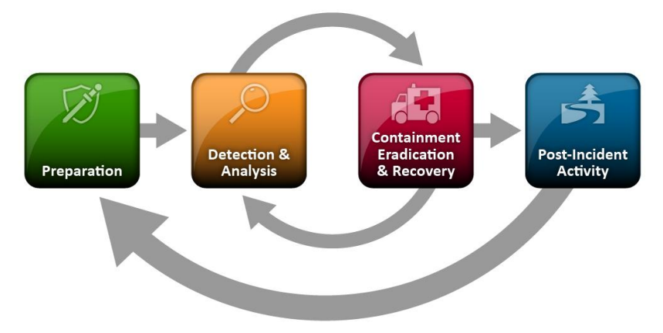
Cyber Incident Response Steps
The IT/OT and Operations Section Staff work while ICS4ICS manages incident
PREPARE with leadership engagement, strategic planning, and staff training exercises
DETECT events by identifying attack vectors and indicators
SOC escalates events to OT, IT, and/or CIRT staff
ANALYZE, prioritize, and escalate events, as necessary
OT/IT does initial, and Operation Section repeats analysis
OT/IT or CIRT escalates events to IC for declaration
CONTAIN the incident to reduce further damage
OT and IT need to make decision quickly to limit spread of cause
ERADICATE the source of the event (same time)
Operation Intel Team works to eradicate cause
RECOVER and restore systems to normal (same time)
Operations Section works on Recovery Alternatives
CONDUCT POST-INCIDENT reviews for lessons learned and evidence retention
¹NIST SP 800-61 Rev. 2, Computer Security Incident Handling Guide

Slide 14
OT Support Need during normal operations & incidents
OT Roles and those they work with
ICS4ICS (Incident Command System) provides management oversite to all roles
OT Roles
OT Engineer designs solutions and support processes (level 3)
OT Analyst performs many routine functions (level 2)
OT Technician maintains the automation and control systems (level 2)
OT Cybersecurity Analyst manages security and works w/ Cybersecurity Engineer (level 2)
OT Network Analyst manages OT network segmentation... (level 2)
IT Roles
Cloud Analyst manages cloud design and processes (level 2)
IT Desktop Analyst assists OT staff as SME on desktops (level 2)
IT Network Analyst assists OT staff as SME on network and may provide support (level 2)
IT Server Analyst assists OT staff as SME on servers (level 2)
IT SysAdmin may provide admin support for OT systems (level 2)
IT Helpdesk (level 1)
Cybersecurity Roles
ICS4ICS Intel Officer coordinate cyber efforts (level 3)
CIRT (SOC) monitors and manage incidents (level 1)
Cybersecurity Engineer designs/manage security (level 2)
Forensics Analyst(s) investigate details and advise (level 2)
Threat Intel / Vulnerability Analyst assessing current and future threats and vulnerabilities (level 2)

Slide 15
Shared tasks performed by multiple roles Tasks are often shared by multiple roles from design to execution
Multiple roles share some tasks: senior people often define processes AND junior staff execute those processes
FOR EXAMPLE: Access Control Administration tasks:
IT Cybersecurity Eng creates and documents company-wide Access processes, and selects tools and trains staff
OT Cybersecurity Eng customizes and documents Access processes for OT and trains support staff to execute these processes
OT Analyst/Technician executes these access processes

Slide 16
ICS4ICS: Staff Planning using WFD Enabling Asset Owners to obtain skills to staff ICS4ICS/Cyber Response Team
Staffing Needs
Determine what roles are required during a Cyber Incident including ICS4ICS roles
Assessing Staff skills
Use WFD Self-Assessment Tools to evaluate skills and knowledge of current company staff
Staffing Alternatives
Develop plan to train or mentor existing company staff to address their skill gaps
Staffing Agreement
Evaluate staffing options: Integrator/MSP, Vendors, Tech Companies, and/or mutual aid
Engage staffing providers to fill required roles and obtain pricing, contract, etc.
Use WFD Self-Assessment Tools to verify alternative staff have required skills
Identify skill gaps your staff have that prevents them from performing critical tasks
Identify the people who are currently performing existing required roles

Slide 17
ICS4ICS: Staff Planning using WFD – Step 1 Understanding your staffing needs
Determine roles required during a Cyber Incident including ICS4ICS:
Review ICS4ICS WFD Roles summary to understand possible required roles
Determine required roles based on technologies/systems at your company
Consider the need for two-shift operations, with duplicate staff for each role
Identify people who are currently performing existing required roles
Document people who perform the required roles so they can self-evaluate
Identify roles that are not currently staffed but are required
Notes:
ICS4ICS-WFD-Summary-of-all-role-tasks.doc

Slide 18
ICS4ICS: Staff Planning using WFD – Step 2 Assessing staff skills
Use WFD Self-Assessment Tools to evaluate skills/knowledge of current company staff
Each staff member (including Integrators/MSP/consultants) take self assessment to determine if they can perform the tasks based on their skills/knowledge
The tool focuses on skills required to perform the tasks
Identify skill gaps your staff have that prevents them from performing critical tasks
The WFD Self-Assessment Tool will provide a list of skills/knowledge gaps for each of the individuals who perform the required roles

Slide 19
ICS4ICS: Staff Planning using WFD – Step 3 Understanding staffing alternatives – Develop your staff
Develop plan to train or mentor existing company staff to address their skill gaps
Determine if training and mentoring can be used to address skill gaps
Consider the costs and time required to complete training/mentoring
Develop a plan to fill roles until staff can obtain skills identified as gaps

Slide 20
ICS4ICS: Staff Planning using WFD – Step 3 Understanding staffing alternatives – staff via external parties
Evaluate staffing options: Your company may use a combination of staffing options
Vendors of OT system, IT support components, networks, and other components may be critical to help investigate incident and provide solutions including recovery
System Integrators, MSP, and other consultants may perform day-to-day support or periodic system upgrades
Reciprocal Agreements with other companies like yours who agree to support each other if one of your companies is impact
Paid services companies provide staff to perform high tech functions that are critical to investigate and result incidents, like forensics, malware reverse eng.

Slide 21
ICS4ICS: Staff Planning using WFD – Step 3 Understanding staffing alternatives – common roles staffed externally
Roles often staffed externally:
Intelligence Officer
Malware Reverse Engineer
Forensics Analyst: Network, Host, and other
OT System Analyst
OT Communications Analyst
Roles that MAY be staffed externally:
Legal counsel for gov reporting and/or Privacy
Cyber insurance company roles – may be required in contract
Government and other data resources may be able to help or provide information

Slide 22
ICS4ICS: Staff Planning using WFD – Step 4 Assessing staff skills
Engage staffing providers to fill required roles and obtain pricing, contract, etc.
Work with staffing providers to determine pricing, contract terms, etc.
Contract/Agreement template is included in the ICS4ICS Mutual Aid template
Ensure contract requires alternative staff to participate in exercises
Contract must address staffing companies' limitations to support numerous assets owners impacted by the same or similar incidents at the same time (is your company a priority?)
Use WFD Self-Assessment Tools to verify alternative staff have required skills
Alternative staff should verify they have the skill to perform required tasks

Slide 23
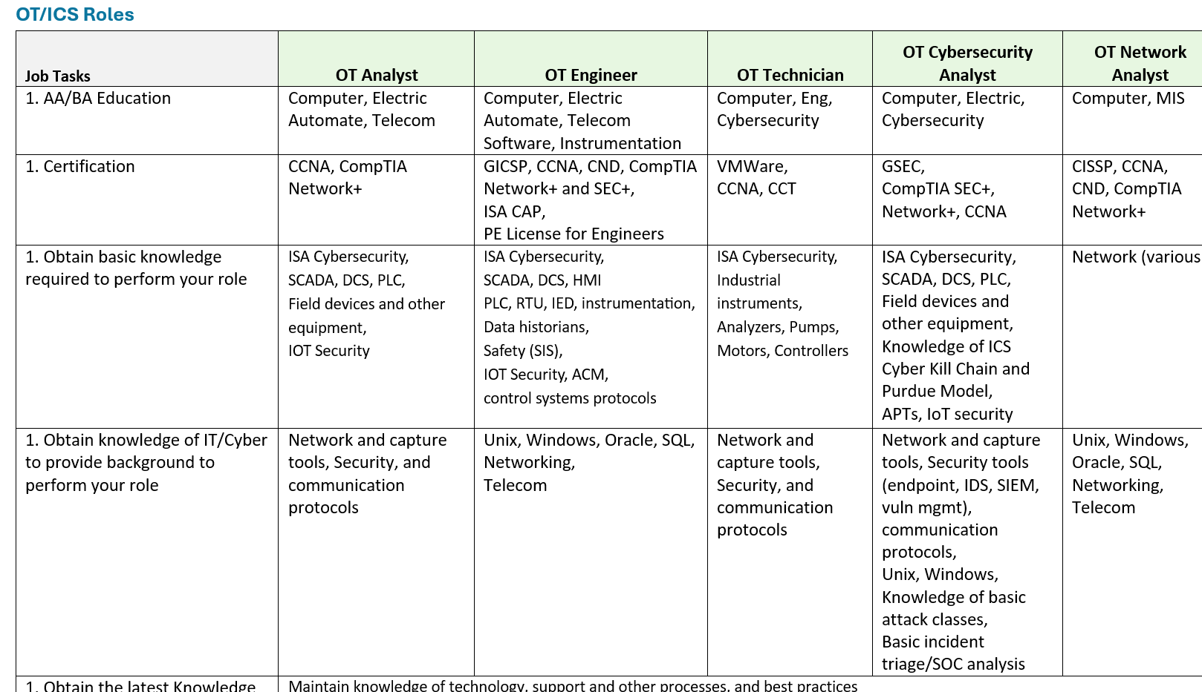
WFD Self-Assessment Role Summary (example) Understanding job roles tasks & skills data

Slide 24
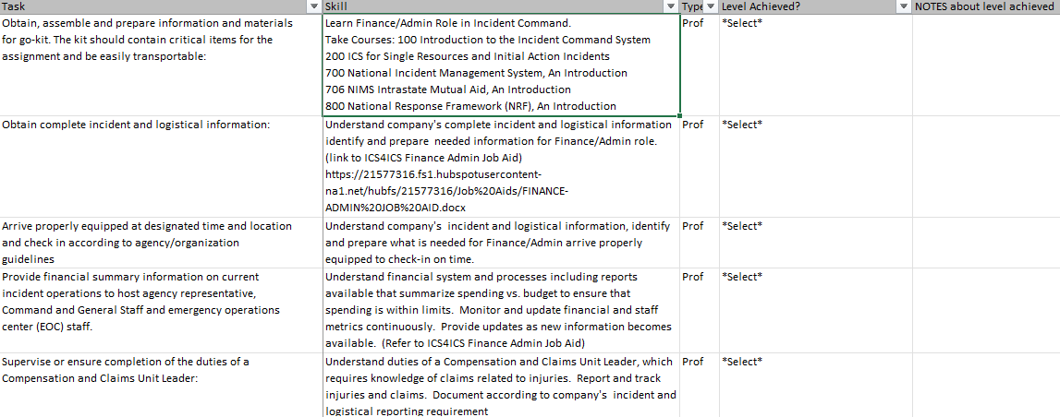
WFD Self-Assessment Tool (example) Staff complete self-assessment based on the tasks & skills data
Drop-Down Box: Completed
In-PROGRESS
Planned
Not Possible
Text Field:
Notes about status of LEVEL and plans

Slide 25
Getting Involved in ICS4ICS
Notes:
We will talk more about some of the other activities we are still work on to improve the ICS4ICS Program.

Slide 26
ICS4ICS and you How can you get involved?
Visit or website: www.ics4ics.org
Register for the ICS4ICS Newsletter
Observe or Participate in an ICS4ICS exercise
Host an ICS4ICS exercise at a public event or in your company
Join an ICS4ICS team to help define the processes, training, etc.
Consider presenting ICS4ICS at a future event
Contact Brian Peterson bpeterson@isa.org for more information
Notes:
You are welcome to view materials on the ICS4ICS website and MS Teams site. We always like to receive input and feedback.
Consider registering to receive the ICS4ICS Newsletter so you can follow our progress and provide input to shape the program.
Host an ICS4ICS exercise or participate in one of the planned exercises. The newsletter will share information about these exercises.
We are always looking for people to join the ICS4ICS Team to help shape the program.
We are also seeking people to present at various events to help others learning about ICSICS.
Please contact Brian Peterson if you want to get involved.

Slide 27
Q&A

Slide 28
Next Steps: ICS4ICS WFD data uses Staff complete self-assessment based on the tasks & skills data
ICS4ICS will leverage WFD data to improve various processes:
Post WFD Self-Assessment Tools for each role
Document WFD Self-Assessment Tools and relationship to ICS4ICS Mutual Aid
Educate ICS4ICS Members and others to use the WFD Self-Assessment Tools
ISAGCA webinar (sponsored) to share WFD and Mutual Aid
Update ICS4ICS Job aids for each of the roles and make connect to WFD tools
External uses of ICS4ICS WFD data:
Update Cyber-CHAMP to include the ICS4ICS WFD data (Shane)
Provide data to USA Gov Whitehouse for AI analysis (Brian)
Provide ICS4ICS WFD data to NIST NICE for possible inclusion in their work (Shane)
Share ICS4ICS WFD data with ISA-99 WG 15 & 10 (Shane/Heidi)
Invite ISU (Idaho State University) including ESTEC to webinar (Heidi)
Reach out: UK (Tim Harwood), SG/others (Shane)

