Slide 1




ISAGCA Webinar Series
ICS4ICS and Dragos Joint Exercise
Incident Command and Cyber Incident Response

Slide 2
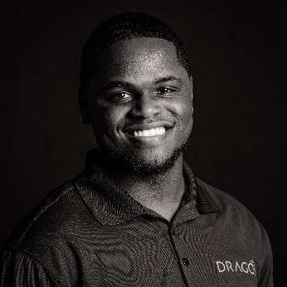
Quindel Turner is a Senior Industrial Incident Responder II at the industrial cyber security company Dragos, Inc. where he provides tailored incident response, compromise assessment, threat hunting, consulting, and digital forensic services for ICS/OT environments.
Dragos, Inc. | Professional Services | Threat Operations Center
Cell: +1 667-335-1112
Email: qturner@dragos.com

Slide 3


Brian Peterson is an Information Risk Consultant who works for ISAGCA as the ICS4ICS Program Manager. He also works for other companies as a program and project manager and conducts research related to IT systems, applications, and SCADA/DCS systems, such as those used in the oil and gas, manufacturing, and other industry sectors.
International Society of Automation| ICS4ICS Program Manager
Cell: +1 925-953-3000
Email: bpeterson@isa.org

Slide 4
ICS4ICS: Tabletop Exercise Objectives & Rules
Objective 1: Understand how the Incident Command System improves cyber incident response efforts through management and administration
Objective 2: Foster improved communication channels among Incident Command, OT, IT, and Operations teams.
Objective 3: Detect and address deficiencies within existing incident response frameworks, procedures, and plans.
Rule 1: Accept the scenario as feasible and engage with the events as they are outlined—reality within this exercise is what the scenario presents.
Rule 2: Understand that multiple solutions may be effective. There isn’t necessarily one "correct" response.
Notes:
These are the ICS4ICS Exercise OBJECTIVES and Rules for the exercise.
You will learn to leverage the Incident Command System to manage Incident Response efforts
Another objective is to enable you to Improve communication between Incident Command, OT, IT, and Operations
Identify gaps in incident plans, structures and processes
The first rule is that the scenario is plausible, and events occur as presented
Do not “fight” the scenario
The second rule is to understand that multiple solutions may work to address this exercise scenario. We are presenting one approach but there is no correct answer.

Slide 5
ICS4ICS Uses Existing Capabilities
ICS4ICS
Incident Command
Industrial Control
Cyber Security
Incident Command System
  Command structure used to manage incidents since the 1970s
Cybersecurity: Computer Incident Response
  Investigation capabilities to manage cybersecurity incidents that are widely used by IT organizations
Industrial Control System
  Experts with industrial knowledge and expertise to respond to incidents
Notes:
ICS4ICS combined 3 capabilities that already exist in most companies. The goal is to improve management of cybersecurity incidents that impact Industrial Control Systems. These capabilities can be used for non-cyber incidents that impact industrial operations.
The NIMS/Incident Command System was created in the 1970’s. There are similar versions used in numerous countries.
Cybersecurity teams leverage Computer Incident Response processes defined by NIST and other organizations to investigate cyber incidents with the goal to minimize the impact of incidents, and provide information needed by leadership that enables them to quickly make decisions that lead to the resolution of incidents.
Industrial Control System experts currently manage the technical aspects of many type of incidents including cybersecurity incidents. Their knowledge of their systems enable them to identify alternatives to recover critical business functions they support and respond to cyber incidents.
ICS4ICS combines these three processes and leverages the unique expertise of each group to expedite the response and resolution of cybersecurity incidents.

Slide 6
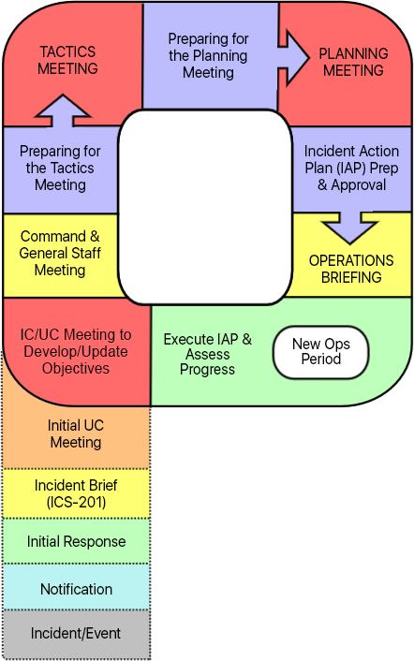
‘Planning P’ Incident Command Process
Offers a proven, structured methodology for incident management.
Ensures standardized organization and execution of tasks.
Delineates a clear sequence for meetings and briefings.
Employs Incident Command System forms and worksheets.
Systematizes actions and work products of team members for cohesive, efficient response.
Initial Response
Notes:
The Incident Command System has a Planning P process to manage All-Hazards. The Planning Cycle consists of the detailed steps necessary to guide the ICS4ICS Team through the five phases of the planning process to develop, disseminate, implement, and adjust an Incident Action Plan (IAP) based on the Incident Objectives.
The All-Hazards Planning Cycle provides a systematic, standardized, and effective approach to organizing response to incidents. After the initial response, the Planning P defines the operational cycle which is repeated. The Planning P operational cycle likely will be repeated multiple time even as a new shift of staff arrives to staff the effort. Planning P provides structure by:
Prescribing the order in which meetings or briefings occur. AND
Identifying the person responsible for collecting incident data and the parties who will make decisions. AND
Defining the actions and work products that are assigned to each of the ICS4ICS teams
We’ve developed Training Videos that explain ICS4ICS and the Incident Planning Process. If you have not seen these videos, you can view the Training by visiting the ICS4ICS website.

Slide 7








ICS4ICS Organization Chart: Start Small
Unified Command (Physical and Cyber)
Public Information Officer (Comms)
Legal Counsel
Safety Officer
Liaison Officer
Operations Section Chief
Intel Officer
Planning Section Chief
Logistics Section Chief
Admin/Finance Section Chief
Malware Reversing
ICS Systems Analysis
Resources Unit
Cyber Support Specialist
Procurement
Network Forensic Analysis
Branches/ Divisions/Groups
Situation Unit
Staffing Group
Insurance Claims
Host Forensic Analysis
Strike Team
Documentation Unit
Communications Unit
Cost/Timekeeper
Comms Analysis
Task Force
Demobilization Unit
Food Unit
Notes:
The ICS4ICS Organization may start with a few key roles to better understand the incident complexity
In this example the Incident Commander decided to activate the Safety Officer, Public Information Officer, Operations Section Chief, and Planning Section Chief
Each Section Chief will be responsible for all position under them until they are staffed
The Incident Commander is the ultimate decision maker, and the other roles provide input to their decisions
The PIO will manage internal and external communications and develop all messages.
The Safety Officer will help ensure the safety of all company staff, the ICS4ICS Team, and company assets
The Operations Section leads the team that works to resolve the incident including OT/ICS System staff, IT staff, and External Technical Staff like the INTEGRATOR and Vendors

Slide 8

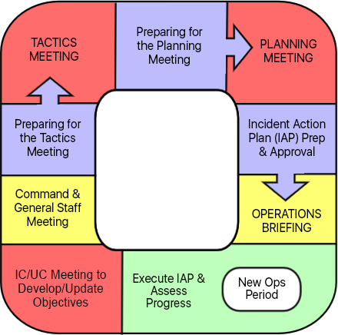









Color-Coded ICS4ICS Meetings, Briefings, and Work Sessions
0000/1200
HOURS
All Members
0200/1400
HOURS
OSC
PSC
SOFR
LSC
IC
FASC
LSC
PIO
And Cooperating Team(s)
All Members
OSC
PSC
SOFR
2200/1000
HOURS
All Members
All Members
530/1730
HOURS
Meeting
START
1800-0600
HOURS
All Members
Briefing
IC
PSC
Working
UC if exists
Notes:
Some of the meetings repeat similar agendas because pre-work is needed, and new attendees are added to subsequent meetings.
The Planning P Meetings only include ICS4ICS Team members who are needed to accomplish the agenda of each meeting. Other people are working independently on their action items and/or collaborating as needed to prepare for their future meetings and action items.
The Incident Commander and Planning Section Chief attend the Incident Commander Objectives Meeting
All ICS4ICS Team members attend the Command & General Staff Meeting; after the meeting, all team members will work to prepare for the Tactics Meeting or work on other action items
The Operations Section and Planning Section Chiefs meet with the Safety Officer at the Tactics Meeting and may be joined by the Logistics Section Chief who provide advice
The Planning Meeting includes most of the ICS4ICS Team members and may include business team representatives who provide input
The Operation Section and Planning Section Chiefs work with the Safety Officer on the IAP Prep and approval work; Most other ICS4ICS Team members will also be working to prepare for the Oerations Briefing
All ICS4ICS team members participate in the Operations Briefing to get execution plans that they can share with the 2nd shift
The Incident Commander will initiate a 2nd shift if the incident is not under control; and everyone will start executing the plan

Slide 9
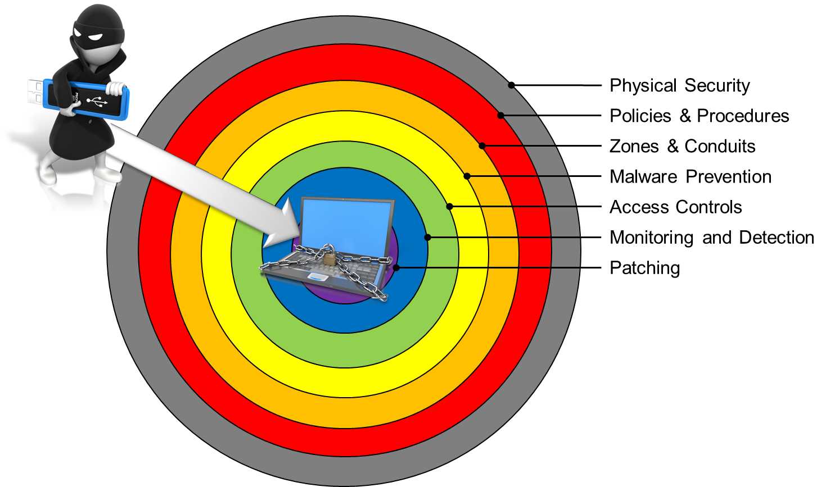
Cybersecurity: Layered Approach to Protection
Cybersecurity: Layered Approach to Protection
“Defense in Depth” — Implementing Layered Security in a Stratified Approach
Notes:
Cybersecurity capabilities are deployed to provide multiple layers of protection.
No single cyber defense measure (no Silver bullet) that can absolutely protect against cyber attacks
We rely on layers of cybersecurity capabilities, called defense in depth. The intent is to delay or completely prevent an attack. An attacker must break though numerous layers to successful attack the environment. !! These layers include:
Physical Security of assets and the components and systems that are used to operate those assets
Cybersecurity policies and procedures, including user training,
Zones & Conduits separate network segments with a protective device
Anti-Malware solutions prevent various forms of malware from compromising the environment
Access Controls are critical because weak unauthorized access has caused numerous cyber attacks
Monitoring and Detection helps quickly identify potential attacks so immediate action can be taken to limit their consequence and prevent an event from escalating into an incident
Patching has remained an important measure to prevent known vulnerabilities in software
Even if more than one layers of protection fails, the other layers are designed to prevent or limit the impact of attacks

Slide 10
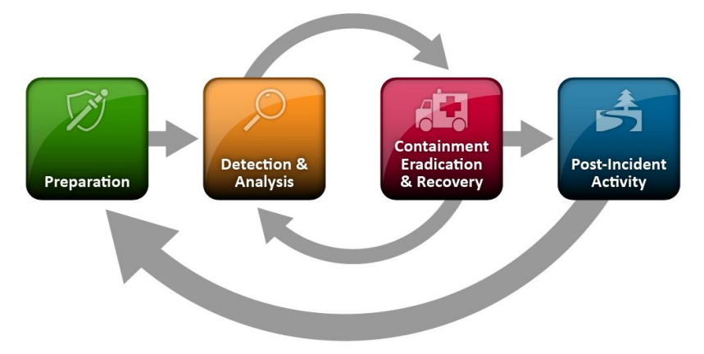
Computer Incident Response Phases
Event escalation occurs post-analysis, in alignment with NIST guidelines.¹
PREPARE with strategic planning and staff training exercises.
DETECT events by identifying attack vectors and indicators.
ANALYZE, prioritize, and escalate events as necessary.
CONTAIN the incident to reduce further damage.
ERADICATE the source of the event.
RECOVER and restore systems to normal.
CONDUCT POST-INCIDENT reviews for lessons learned and evidence retention
Forensics can be involved at any phase.
¹NIST SP 800-61 Rev. 2, Computer Security Incident Handling Guide
Notes:
Most organizations have Computer Incident Response capabilities. This includes a plan and staff who are trained and participate in regular exercises to ensure they are ready to respond to a cybersecurity incident.
Detection of events is an important aspect of any cybersecurity program. Numerous events are identified by detection tools and log messages from applications, servers, and network devices. A large company probably has millions of events occurring daily.
A Computer Incident Response Team (CIRT) analyze events to identify those that present a potential risk and require further investigation and possibly additional action.
The CIRT takes immediate actions to contain events to prevent them from causing additional negative consequences.
They also eradicate the source of the event and if necessary, take actions to restore data and systems.
A Post-Incident review is completed to understand how these CIRT processes can be improved and to retain evidence from the event.

Slide 11

Mutual Aid & Third-Party Staffing Contracts

Slide 12
Mutual Aid & Third-Party Staffing Contracts
Many companies and organizations will need to obtain assistance from external parties to help them staff the various cyber incident response and ICS4ICS roles
  Vendors of IACS system, IT support components, networks, and other components may be critical to help investigate incident and provide solutions include recovery
  System Integrators and other consultants may perform similar roles as the vendors
  Reciprocal Agreements with other companies like yours who agree to support each other if one of your companies is impact
  Paid services companies provide staff to perform various functions that are critical to investigate and result incidents, like high tech functions

Slide 13
Mutual Aid Procedure Template
Mutual Aid Process:
Understand the type of organizations who can help during an incident
Assess the roles and number of people needed during an incident
Evaluate your staff to understand their capabilities to fill needed roles
  WFD Assessment Tools are being finalized
Establish agreement for supporting orgs
Define an organization structure so supporting staff have reporting relationship
Include them in ICS4ICS/IR exercises
Common roles staffed externally:
Intelligence Officer
Malware Reverse Engineer
ICS System Analyst
ICS Communications Analyst
Network Forensics Analyst
Host Forensics Analyst
Dragos defined roles they offer
Roles they MAY be staff externally:
Legal counsel for gov reporting, etc.
Cyber insurance company roles
Government and other data resources

Slide 14
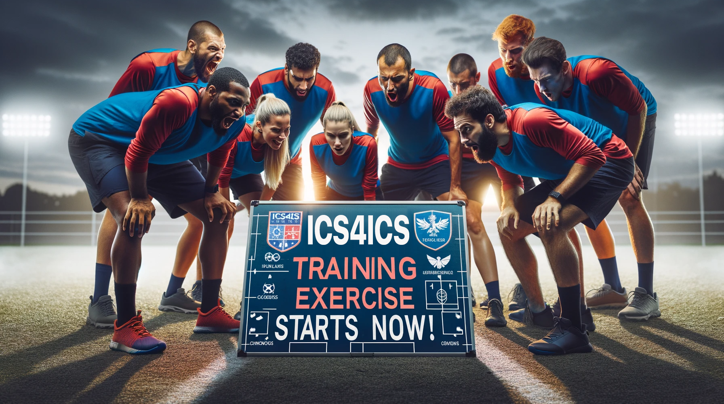
ICS4ICS Training Exercise Starts Now
Notes:
🗣️ Facilitator - FAC-name
The exercise will start now

Slide 15
Background
The “CYPHER” adversary is an active threat group targeting industrial companies, focusing on small to medium-sized organizations.
  So far this year, they have attacked multiple companies and earned millions in ransom payments.
This level of activity has resulted in multiple news stories about them.
  They are looking for their next payout.
In this scenario, Dragos staff and some other players are not at the site but are talking with operators at the site.

Slide 16
Scenario
Operations staff report on of the operations stations is running very slowly, and some pop-up(s) come up and then disappear.
Operations staff also mention that a vendor was onsite last week to show off a new feature on the system
The vendor connected their laptop to the OT network during the demo to access a page but didn’t make any changes to the system

Slide 17
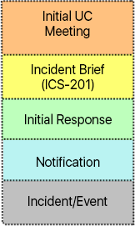
Initial Assessment
Who handles technology problems in your operations?
  When would they get involved (contacted to provide support)?
Would the Incident Commander declare an incident yet?
Is security considered a possible cause of the problem?
Who else is notified of these types of problems?
Does someone follow security alerts (or news)?
  If so, does this information communicated to Operations?
Are there tools or ways to understand what might be occurring?
When does operations engage a Cyber Intelligence Officer, like Dragos?

Slide 18
Incident is disrupting operations
Operations staff at the site are now reporting that an operator workstation is frozen to input
  The operator sees several ODD WINDOWS POPPING UP AND uncontrolled MOUSE movements.
They ask you if the system or integrator is on the system
The site is still running, but the operators can not control or monitor anything from the station
Operations sends Dragos pictures of what they see on the operator screen

Slide 19
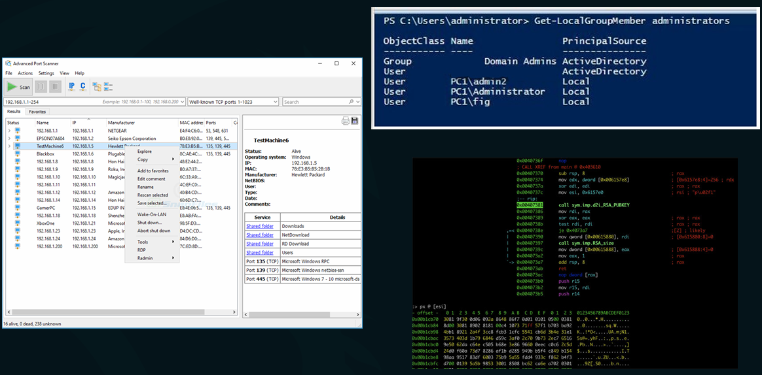
Incident is disrupting operations

Slide 20
Incident is disrupting operations
Would you escalate the event to an authorized Incident Commander to declare an incident?
Do you have a procedure for Escalation-Notification-Declaration?
  ICS4ICS has a procedure template to help you define these processes
Can support staff remotely access the impacted workstations?
What tools do you have to provide visibility into the activities occurring on your systems and network?
How can operators safely verify the current state of operations and potential impacts on IACS systems and processes?
Notes:
🗣️ Operations Section Chief - OSC-name
xxxx

Slide 21
Containment
Has the CIRT been pre-authorized to make decision to contain malware by isolating systems that may be infected?
Are people who execute system isolation tasks available 24X7 and does the CIRT have notification procedures to reach them?
Has the OT network been designed with zones and conduits to prevent malware from spreading?
Does the CIRT have a documented procedure to contain malware? (e.g., isolating system)
Do technical procedures exist with tools to expedite the isolation of impacted system(s)?
PREPARE with strategic planning and staff training exercises.
DETECT events by identifying attack vectors and indicators.
ANALYZE, prioritize, and escalate events as necessary.
CONTAIN the incident to reduce further damage.
ERADICATE the source of the event.
RECOVER and restore systems to normal.
CONDUCT POST-INCIDENT reviews for lessons learned and evidence retention
Notes:
🗣️ Facilitator - FAC-name
These are the questions each of you should ask yourself to ensure you can evaluate Containment procedures to isolate infected systems that may infect other systems on the network
INSTRUCTION: Open the System Shutdown and Isolation TEMPLATE and discuss with the exercise participants

Slide 22
Containment Procedure Template
Containment preparation:
Determine the need to isolate systems and networks that may spread malware
  Similar systems/components are vulnerable
Develop a plan for how these systems and networks would be isolated
Obtain approval to enable onsite staff to make the decision to isolate
  Containment only works when executed immediately after identifying malware
Identify the team that will execute
  Document primary-secondary-tertiary staff
Document procedure including call-out
Containment execution steps:
Assess to determine if this is a cyber incident
Identify risk of spreading to others
Authorized person decides to isolate
  Criteria is defined in Containment procedure
Execute script/tool to isolate networks
  Management will have to be prepared to live with possible consequences of isolation
Determine when to reconnect the impacted network

Slide 23
Incident Commander Objectives Meeting
Notes:
🗣️ Facilitator - FAC-name
The first ICS4ICS meeting is for the Incident Commander to document the incident and develop incident objectives. The Planning Section Chief helps
The ICS4ICS Team will be travelling to join the team while this work occurs

Slide 24
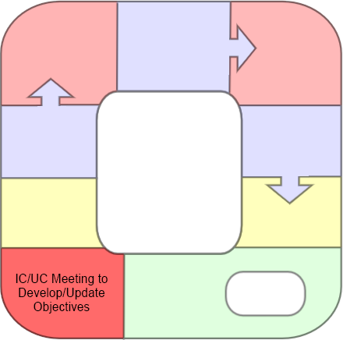
IC Objectives Meeting: Agenda and Priorities
Ground Rules, Agenda
Incident Chart or ICS-201
WHAT IS HAPPENING HERE
Incident Objectives
CIR/IRT ICS-202 (series)
IC
PSC
UC if exists
0600
HOURS
Notes:
The Incident Commander Objectives Meeting will start at 0600 hundred which is 6AM
The meeting will be attended by the Incident Commander and Planning Section Chief
At this meeting, the objectives are developed and/or identified, which will be captured on a flipchart and the documented on the ICS-202 Incident Objectives form
The Incident Commander will announce the Objectives, and during the Command & General Staff Meeting the staff will review and break down the objectives as either Operational or Managerial and assign to the appropriate sections
The Incident Commander determines the following:
What are the Response priorities, like: life safety a great concern, and/or getting the Industrial Control Systems back online and/or Managing Public Information and/or other priorities
The Incident Commander will also determine Limitations and Constraints of the response which might include labor union challenges, local community concerns like noise, a natural disaster or severe weather, or other constraints
The Incident Commander will be the leader for this exercise; Unified Command will not be required because there is no physical response, like a fire or spill; If a physical response becomes required a Unified Command will be formed

Slide 25
Incident Commander Objectives Meeting
Initial Strategy Meeting and Information-sharing Agenda
SPEAKER | TOPIC
PSC | Bring meeting to order. Cover ground rules. Follow the agenda.
IC/UC | Identify Incident Priorities. Identify and discuss Incident Objectives. Establish Incident Operational Period.
PSC (all) | Establish meeting schedule to match All-Hazards Planning Cycle. Open Discussion: Priorities, Objectives, strategies, and issues/concerns.
IC/UC | Describe resource ordering procedures. Describe information release procedure. Assign any incomplete tasks.
PSC | Close meeting.
Notes:
Each of the ICS4ICS meeting have a pre-defined agenda that the Planning Section Chief will modify as needed
The Planning Section Chief facilitates most of the meetings
People from the ICS4ICS team will join this meeting if they are available
The Planning Section Chief will review the agenda, facilitate the meeting and then close the meeting

Slide 26
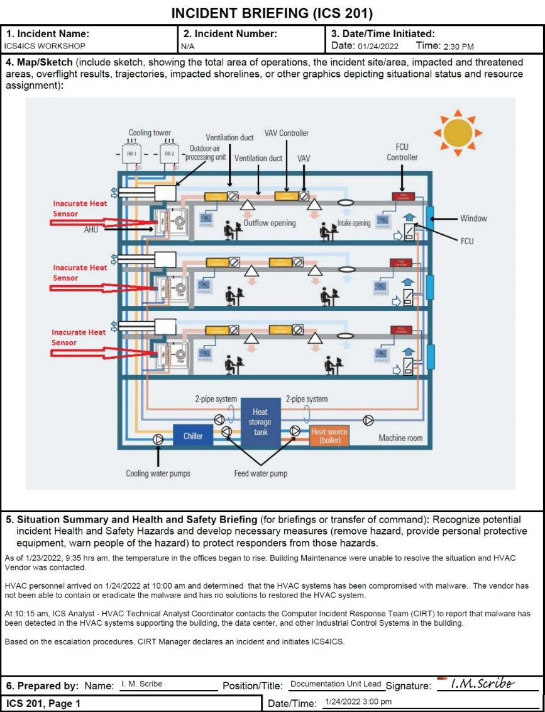
ICS-201: Incident Briefing
1-3
Basic
Incident Info
4
Incident Map
5
Incident Description
Notes:
The IC will create the ICS-201 Incident Briefing Sections 1 to 3 show basic information
Section 4 shows a sketch of the impacted operations which may be a building, logical, or other map
Section 5 summarizes the incident with the information we know about the incident at this time

Slide 27
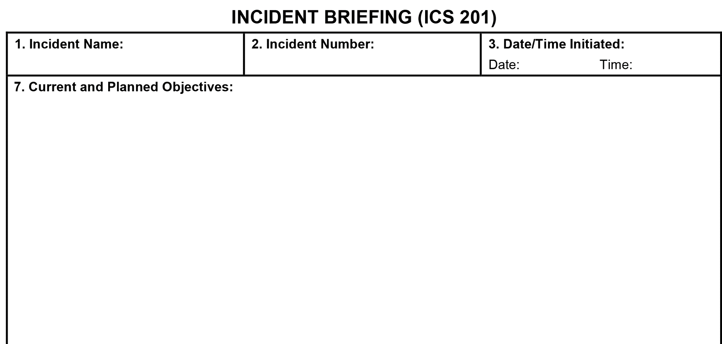

ICS 201 Incident Briefing (Section 7: Objectives)
ICS4ICS WORKSHOP
N/A
01/24/2022
2:30 PM
Ensure safety of staff and assets
Ensure safety of Response Personnel
Maintain proper relationship with the press/media and provide necessary updates
Maintain proper relationship with the stakeholders and ensure adequate/timely updates and proper addressing of the stakeholders' interests
Determine incident mitigation/eradication course of action
Notes:
The Incident Commander will use and modify a template the Incident Objectives that drive incident operations
The Incident Commander decides on operational period which is normally 12-hours
A 2nd shift of people will take over the ICS4ICS team roles, so this team can rest before returning 12-hour later

Slide 28
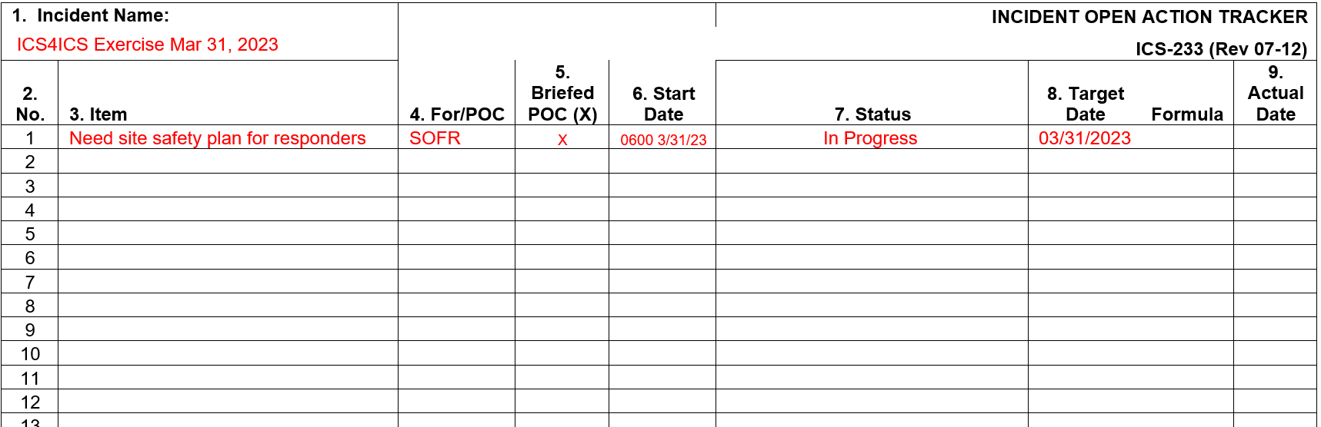
ICS-233: Incident Open Action Tracker
Notes:
The Planning Section Chief will capture and update action items for all meetings.
This data will be used to ensure that everyone knows what they have been assigned and ensure all tasks are completed.
This document also acts as a memory for actions have been completed
In this example, the IC has assigned the SOFR to develop a Site Safety Plan

Slide 29

Government Reporting
Notes:
There is increased need for Government Reporting in numerous counties and industry sectors
ICS4ICS has a Government Reporting procedure template you can use to quickly create a procedures for your company or organization

Slide 30
Government Reporting Procedure Template
Decision Team
Corporate Government Relations
Incident Commander
Operations Section Chief
Intelligence Officer (Ops Section)
Corporate Legal/outside council
Privacy expert, if needed
NOTES:
Template has list of some laws/regs, including PPI
Decision Process (defined prior to incident)
Understand Government Reporting Requirements
  Government reporting requirements
  Reporting timing based on laws/regulations
Review Corporate Policies
  Corp policy define reporting when not legally required
Ensure government reporting performed collectively even if there are different agencies
  Ensure messages are consistent
Identify reporting approval processes
  Authorized approver (defined by CMT)
Notes:
Companies must prepare to make decision and perform government reporting
We have procedure templates posted on our ICS4ICS.org website for this process and many more.
A Decision Team should be formed. You will have to identify the people you believe are needed to make these decisions.
We have a list of know laws and regulations in our Government Reporting procedure template. You have to identify those that impact you.
You also should understand you company policies that may impact government reporting, particularly when not legally required.
Government reporting may need to be done with multiple parties. The message must be consistent to ensure everyone receive the same message(s).
An authorized approver needs to be identified who approves the message and who will receive government reporting.

Slide 31

Command and General Staff Meeting
Notes:
We will talk about the first meeting that brings together the entire ICS4ICS Team.
The technical people on the Operations Section Team will continue to work while this meeting occurs

Slide 32
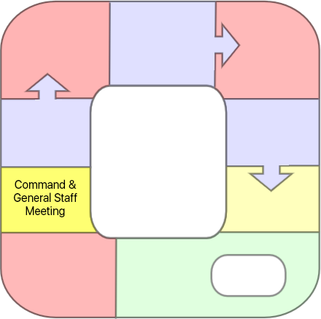

Command and General Staff Meeting
Command and General staff are informed about the incident and the IC describes the vision for managing the incident.
This is the time to ask the IC questions
All Members
1000
HOURS
Notes:
The Command & General Staff Meeting will start at 1000 hundred which is 10AM
This is the time for the Incident Commander, Command Staff, and the General Staff who are the Section Chiefs, to ask questions
This meeting is an open environment where Staff can air dirty laundry and ask questions to clear the air
The Incident Commander defines the length of the operational period (as 12-hours) which will determine when this meeting will re-occur with the 2nd shift staff which starts the timing for the other Planning P meetings 12 hours past 1st shift
The Incident Commander establishes the organization and reminds Section Chiefs that they are responsible for performing actions within their section for positions that have not been staffed

Slide 33
Command and General Staff Meeting
Command and General Staff Meeting Agenda
SPEAKER | TOPIC
PSC (as SITL) | Situation Briefing
IC | Objectives Review / Current Priorities
IC | Functional Tasks – assignments to Command and General Staff
PSC | Roundtable Discussion Clarify priorities, objectives, assignments; Identify/review resource needs; Discuss concerns/issues
PSC | Review Open Action Items
IC | Closing Comments
Notes:
The Planning Section Chief will facilitate this meeting using a pre-defined agenda they modify as needed for the incident
All people on the ICS4ICS team will join this meeting to get information on the incident and directions from the IC.
Each person has already been working to understand the incident. The PSC on-boards team members as they arrive.
The team members begin to respond to the incident based on their role.
They also start to develop their individual tactics and plans for the incident.
The Planning Section Chief will review the agenda, facilitate the meeting and then close the meeting

Slide 34
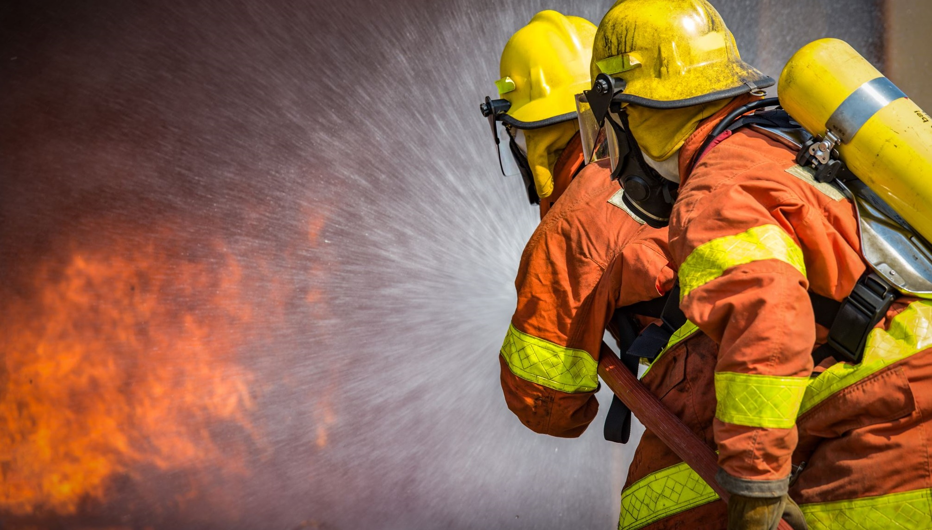
Safety Status Update
Notes:
The Safety Officer will provide status of safety and describe concerns about safety
The describe safety concerns and mitigation strategies to address those concerns
They will provide the team with directions on how they must operate to ensure their and everyone’s safety
They will submit a Resource Request to order order think like an ambulance, security staff, and other resources needed to ensure safety
The SOFR will keep the ICS4ICS team updated of further safety develops and updates to the safety plan

Slide 35
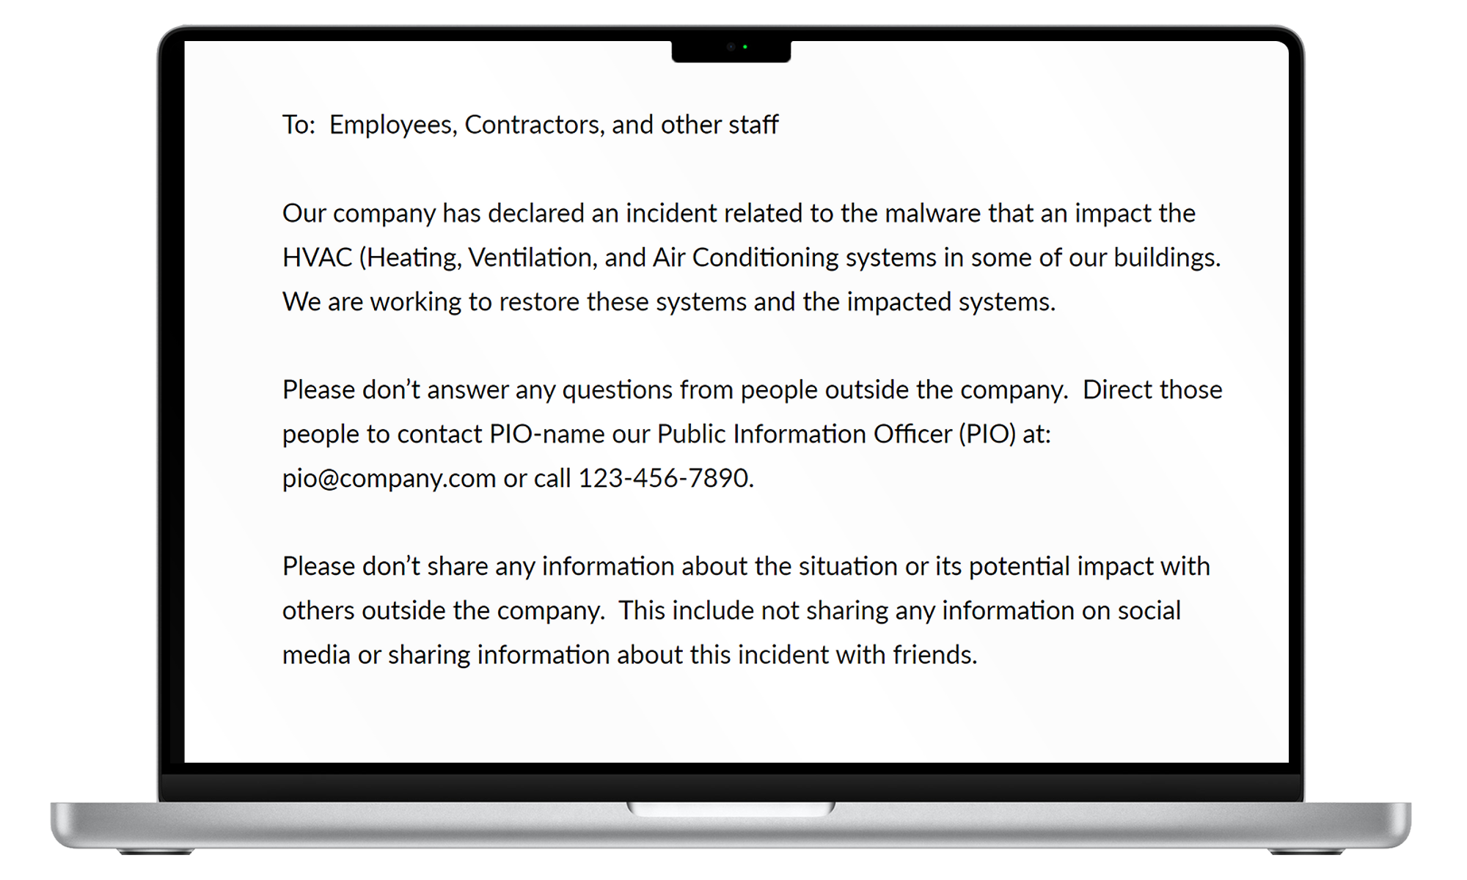
PIO: Public Media Concerns
Notes:
The PIO will draft a communication that senior leaders will send to their staff with a brief overview of the situation and a reminder to direct all media inquiries to the PIO
The PIO develops and manages all communications inside the company with staff, externally with media, investors, customers, and other parties.
The PIO will ensure all messages are factual with limited conjecture. These message are used in various communications include government reporting.

Slide 36
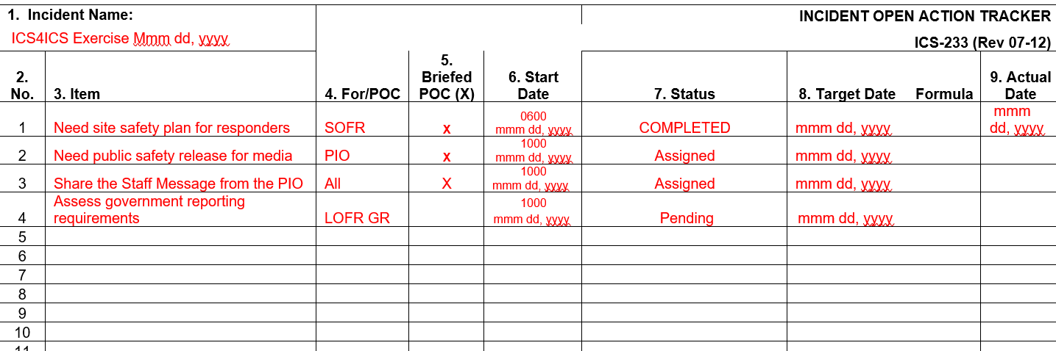
ICS-233 Incident Open Action Tracker
Notes:
The Planning Section Chief (or a Document Unit Leader who reports to them) will use an Incident Open Action Tracker captures action items, key decisions, and other data that needs to be tracked

Slide 37

Preparing for the Tactics Meeting

Slide 38
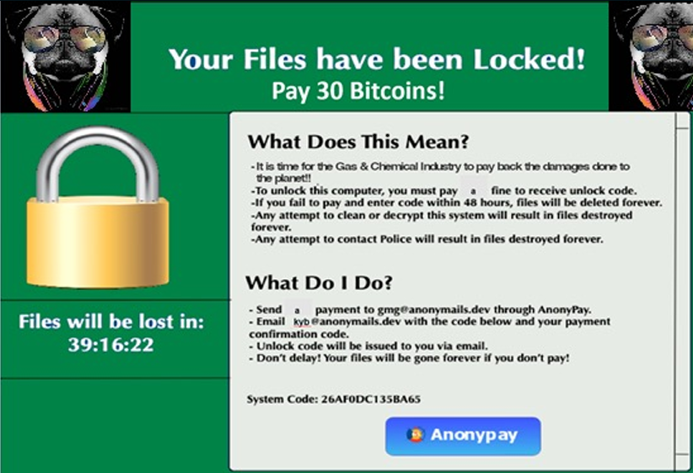
Ransomware Demand
Notes:
Ransomware is becoming a significant risk to numerous industry sectors. In some sectors we are seeing over 100% increase annually in ransomware attacks
They are challenging because the bad guy locks your systems. They may destroy your backup data used to recovery OT and IT systems and components.

Slide 39
Ransomware Procedure Template
Decision Team
Incident Commander
Operations Section Chief
Intelligence Officer (Ops Section)
Safety Officer
Technical Reps/Eng of systems
Corporate Cyber Security
Corporate Legal/outside council
Government Relations
Cyber Insurance Rep, if covered
Public Information Officer
FASC and/or Corp Finance
Privacy expert, if needed
Decision Process (defined prior to incident)
Understand restriction of paying ransomware
Review Corporate Policies which may prohibit payment
Assess ransomware impact: safety, env, business/financial, and impact to company IT and communications
Document a business case for ransomware decision
Understand recovery alternatives / times vs. alternatives to eradicate (remove) malware
Assess likelihood payment works (see URL)
Develop communications strategy, if needed
Align with government reporting
Ensure company has ability to make payment
Identify ransomware approval processes
  Authorized approver (defined by CMT)
Notes:
The company or organization should define a decision team including members that are needed to provide input and/or make the final decision. These slides show examples of people who may be on the Ransomware decision team.
Decision process must be defined and data collected to help the decision team as they make the decision.

Slide 40
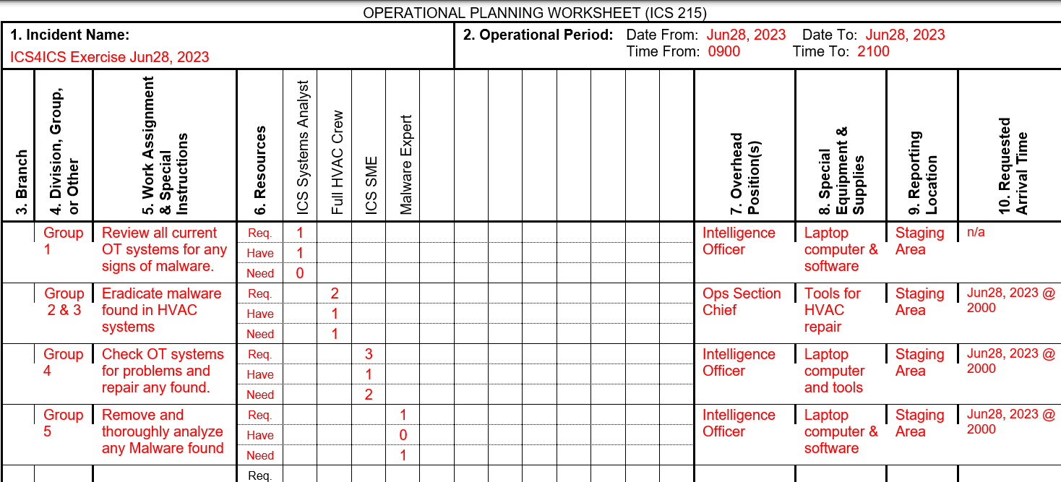
ICS 215: Operations Section Chief
Notes:
The Operations Section Chief will determine how the Operations section should be organized into teams.
Mutual aid partners, vendors, and other external parties may be part of the staff on the various teams.

Slide 41
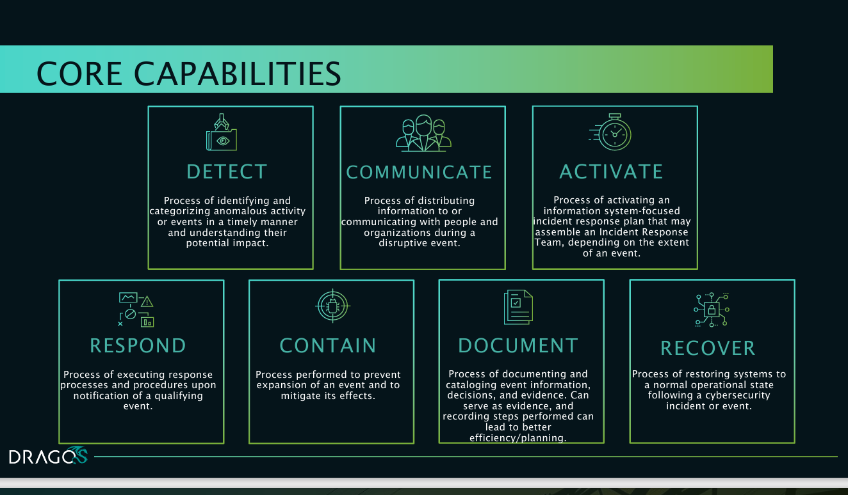

Slide 42






DRAGOS OT-CERT*
FREE CYBERSECURITY RESOURCES
Free content is available for OT asset owners and operators, to help you build and maintain an effective OT cybersecurity program.
Industrial cybersecurity resources for the OT community
OPEN TO GLOBAL ICS/OT COMMUNITY
Content is oriented toward Small and Medium Businesses (SMBs) and resource-challenged organizations with OT environments that lack in-house expertise.
NEW CONTENT
Members have access to a growing library of resources such as toolkits, guides, how-to videos, templates, best practice blogs, tabletop exercises and more, available from the OT-CERT portal.
WORKING SESSIONS
Monthly virtual sessions are offered in 2 convenient time zones for members to get to know each other, ask questions, get advice, and share their successes and challenges.
VULNERABILITY DISCLOSURES
We take a coordinated approach to the disclosure of vulnerabilities, working with vendors to better protect our customers and the ICS/OT community.
*Operational Technology –
Cyber Emergency Readiness Team

Slide 43
ICS4ICS and you
Visit or website: www.ics4ics.org
Register for the ICS4ICS Newsletter
Observe or Participate in an ICS4ICS exercise
Host an ICS4ICS exercise at a public event or in your company
Join an ICS4ICS team to help define the processes, training, etc.
Consider presenting ICS4ICS at a future event
Contact Brian Peterson bpeterson@isa.org for more information

Slide 44
Questions
&
Answers

Slide 45
ISA Cybersecurity Resources
Free guidance, training, and more:
ISA Global Cybersecurity Alliance - www.isagca.org A collaborative forum to advance OT cybersecurity and understanding of ISA/IEC 62443 | ISASecure www.isasecure.org The world’s leading conformance certification program for ISA/IEC 62443 | ICS4ICS www.ics4ics.org Improve how cybersecurity incidents are managed with training, processes, and exercises
Get involved:
ISA/IEC 62443 standards available from ISA (free access with ISA professional membership!)
Cybersecurity training and certificate program
Help develop the standard – open to all at no charge – www.isa.org/ISA99

